Slide 1
Step by Step Process of
E-Voting
Wholly Owned Subsidiary of CDCPL

Slide 2
K-Electric Limited has appointed CDC Share Registrar Service Limited to facilitate Members of the Company for exercising their right to vote through E-Voting system. This is in addition to Physical Voting arrangements at the Venue of EOGM.
E-Voting lines for Election of Directors will be opened for the Members from 05:00 p.m. on 25 July 2022 to 05:00 p.m. on 28 July 2022.

Slide 3
Step#1 Account Login email

Slide 4
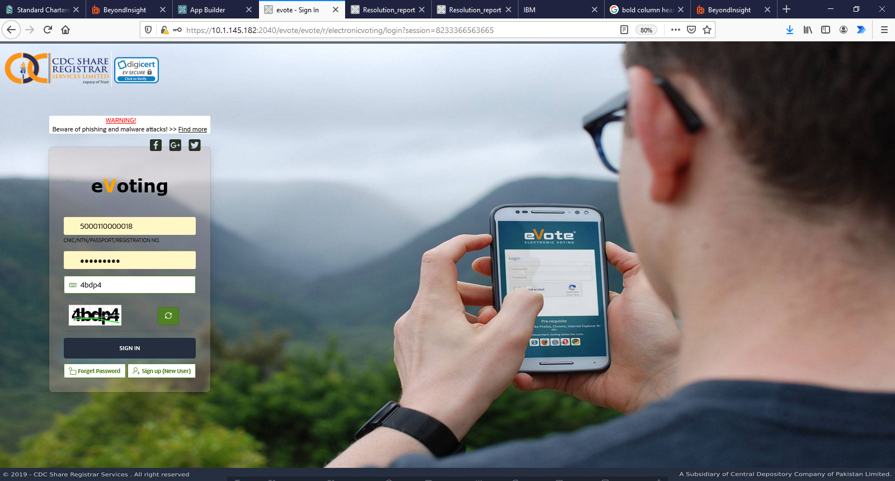
STEP # 2
Sign Up Window

Slide 5
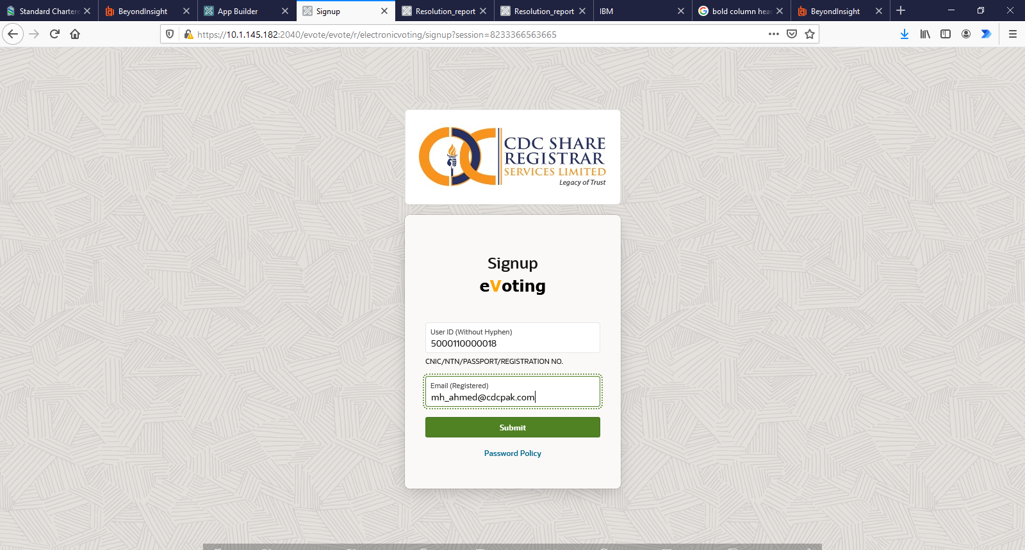
STEP # 3
Setting up Account
User ID will be CNIC/NICP/Passport number of each individual.
Only registered email address will be used to proceed with sign up process.
Wholly Owned Subsidiary of CDCPL

Slide 6
Step # 4 Account Activation Email

Slide 7
STEP # 5
Setting Password
Wholly Owned Subsidiary of CDCPL

Slide 8
STEP # 6
Sign In Window

Slide 9
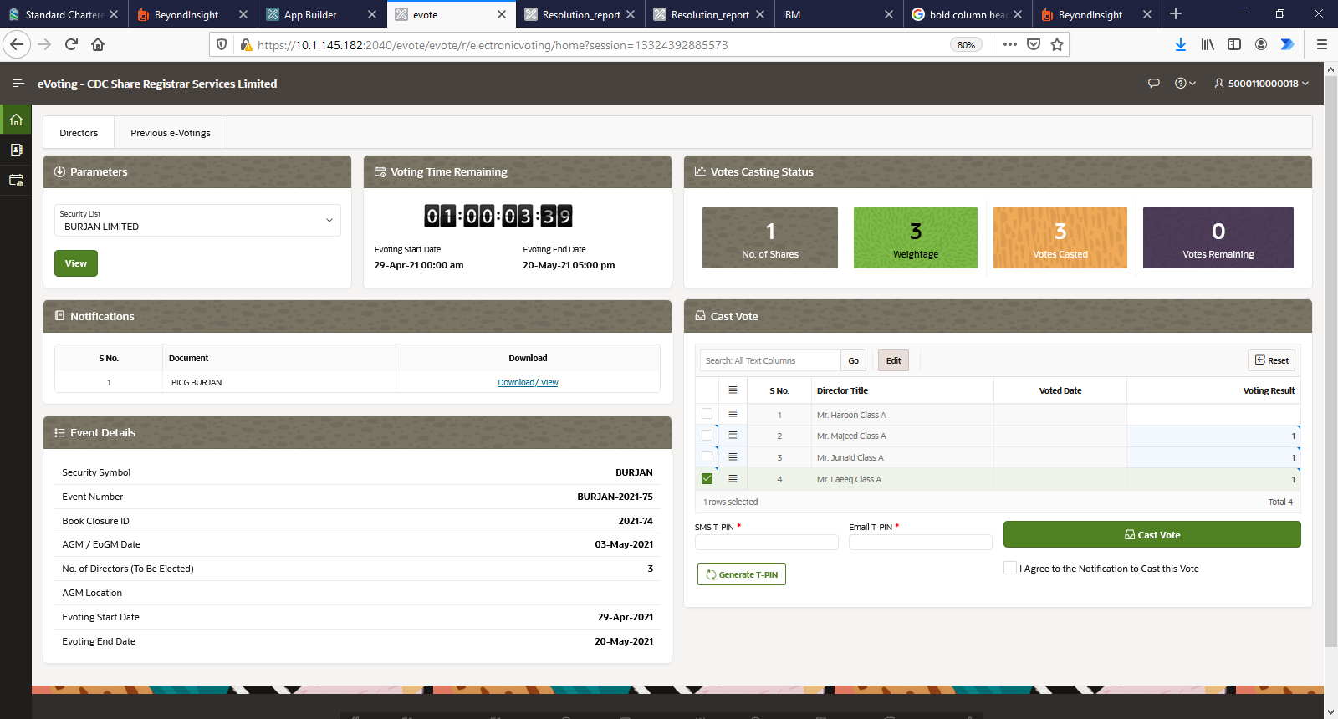
STEP # 7
Welcome Window
Wholly Owned Subsidiary of CDCPL

Slide 10
STEP # 8
Casting Vote
Points:
Assigning vote to contestant.
Click on Generate T-PIN
T-PIN will be sent to respective member on their registered mobile number and email address. Enter the same in respective fields.
After entering respective T-PINS, put check on undertaking statement and click on Cast Vote.
Point 1
Point 3
Point 4
Point 2
Wholly Owned Subsidiary of CDCPL

